Slide 1
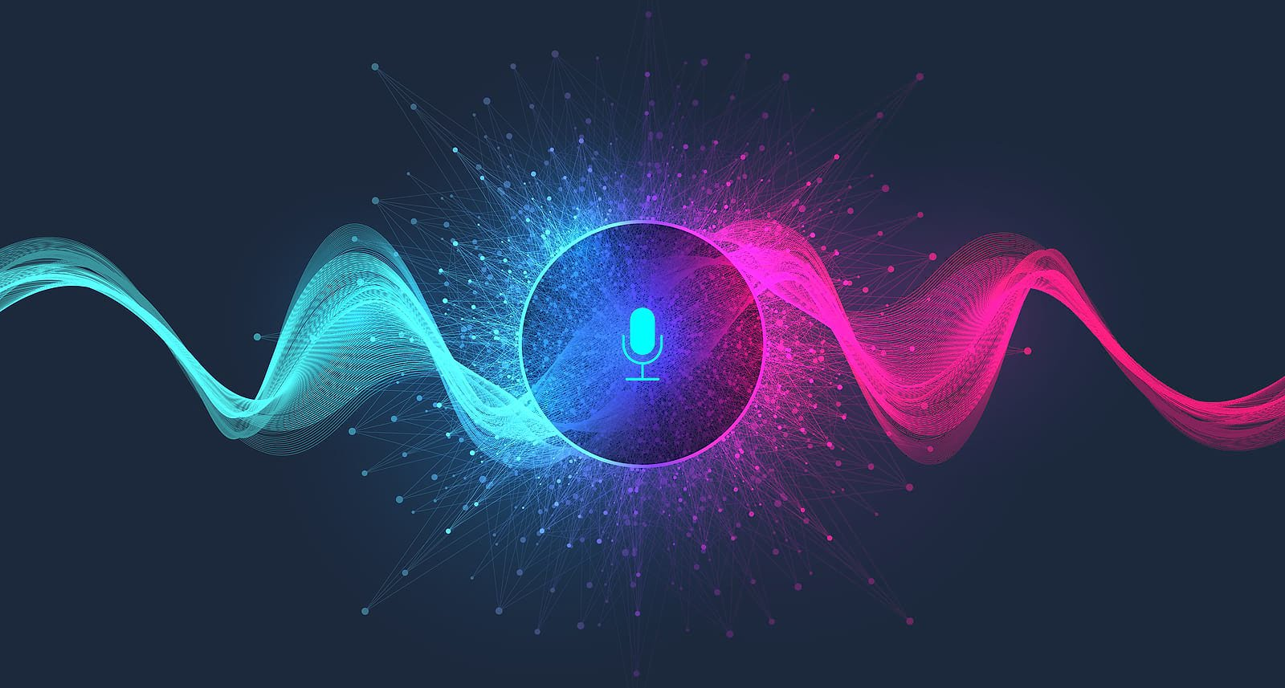
AI Based Personal Virtual Assistant

Slide 2

Supervised by
Tanvir Ahammed
Lecturer
CSE,JNU

Slide 3
01
Introduction
02
Motivation
03
Workflow Diagram
04
Project Demonstration
05
Result Analysis & Limitations
06
Reference
Agenda

Slide 4
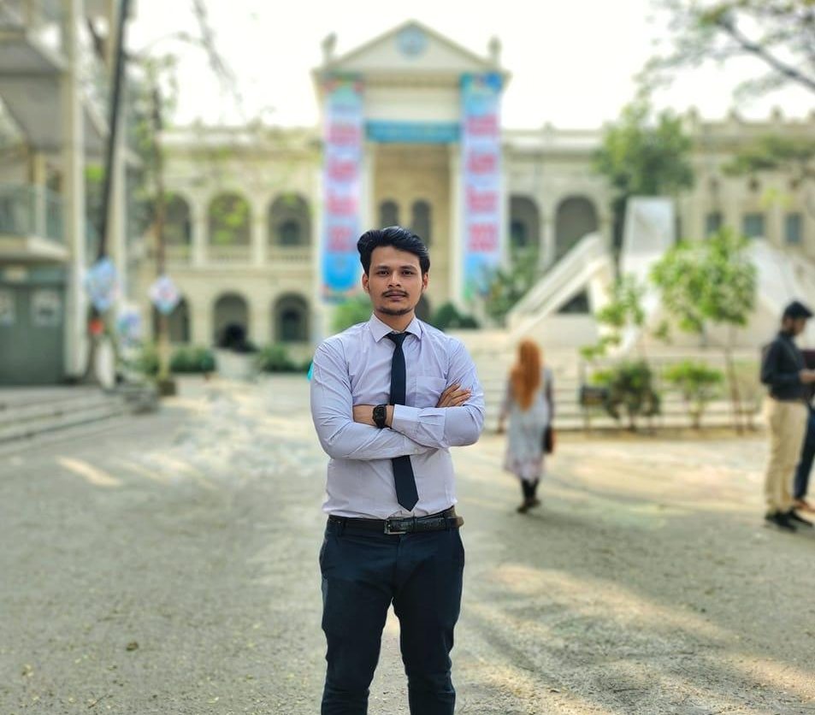
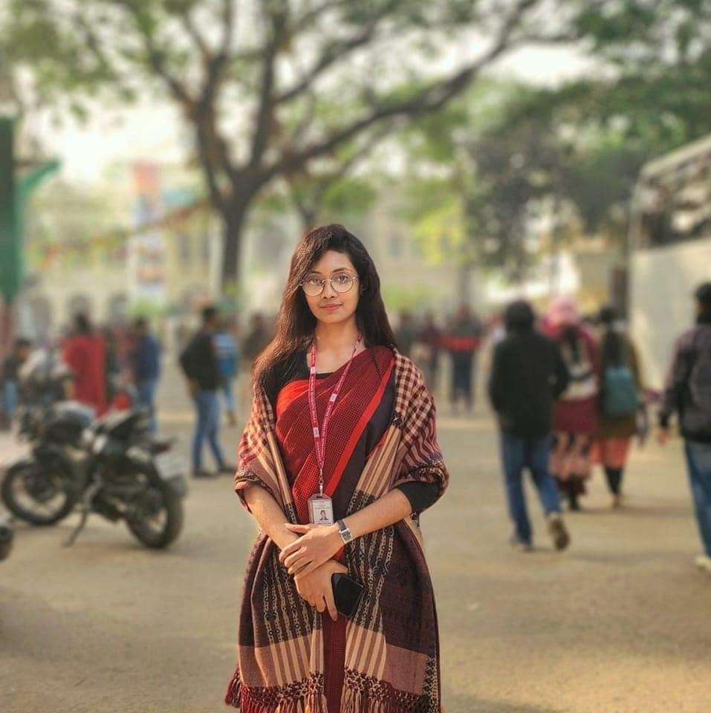
Team Fix_it
MD. Tanvir Ahammed Hridoy
ID: B180305020
Susmita Rani Saha
ID: B180305047

Slide 5
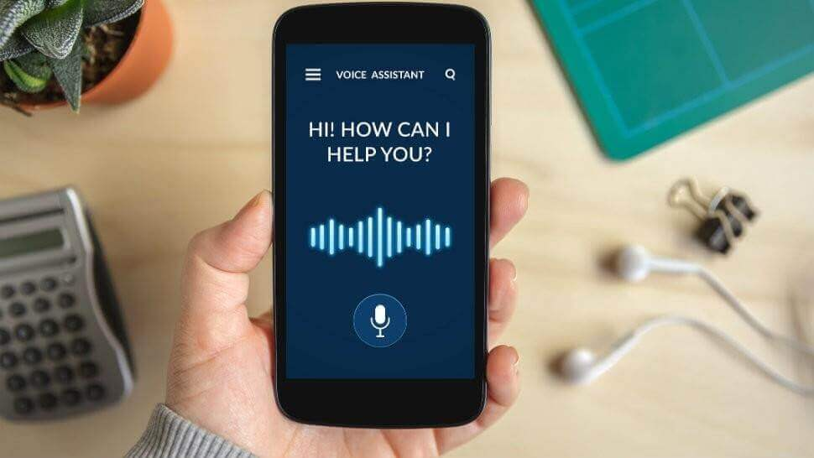
Introduction
Virtual Assistant – AI-based personal voice assistants as intelligent software applications that use artificial intelligence and natural language processing techniques to understand and respond to human voice command
Virtual Personal Assistant carry out all thetasks that are too complex for you on a daily basis.
Natural Language Processing – a subfield of computer science, concerned with the interactions between computers and human (natural) languages.

Slide 6
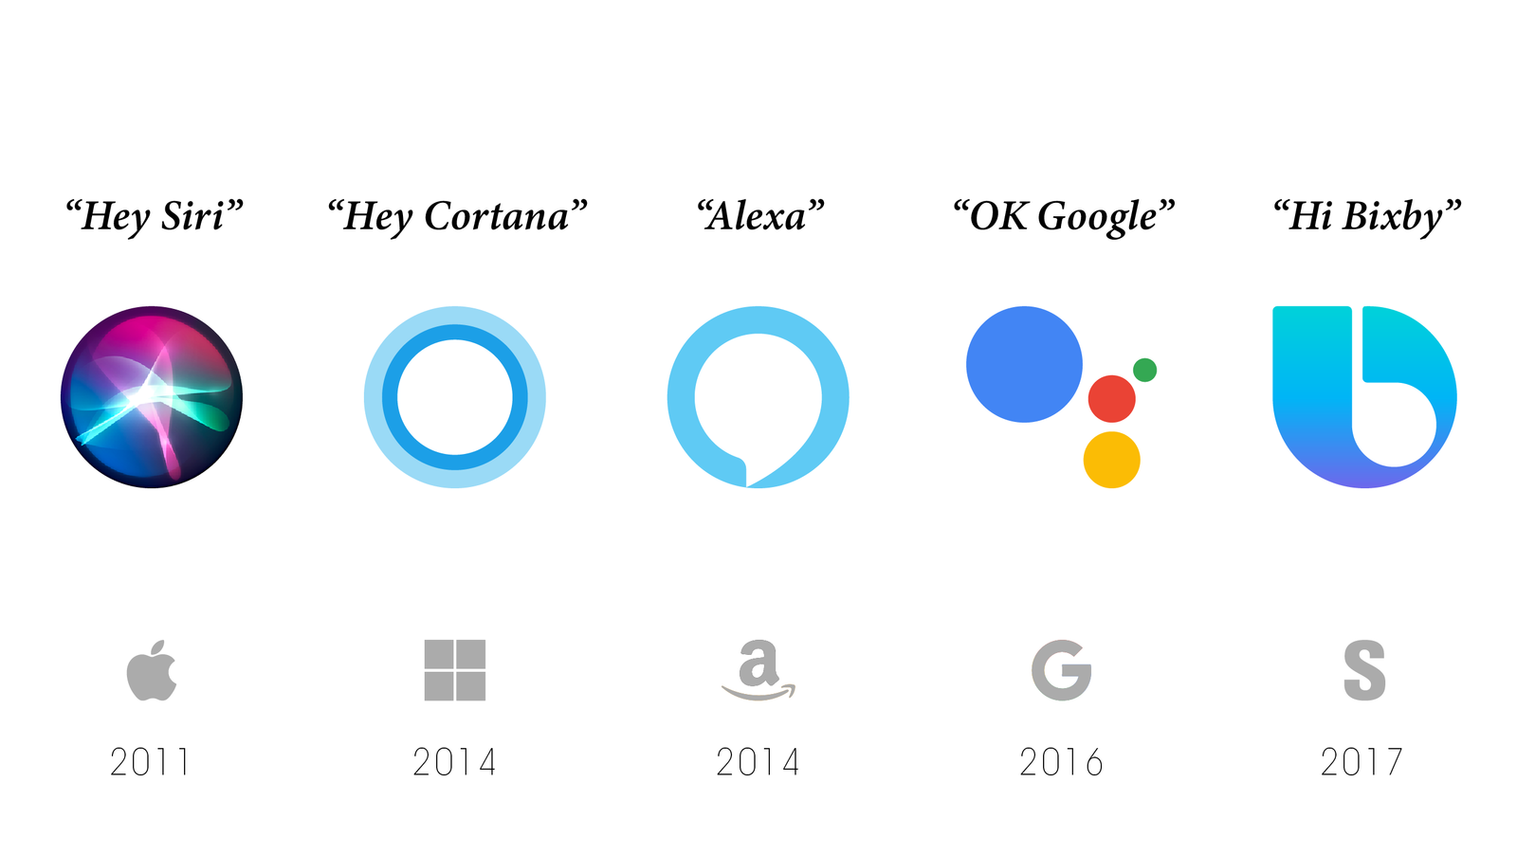
Introduction
Popular virtual assistants - Amazon Alexa, Apple's Siri, Google Now and Microsoft's Cortana.

Slide 7
Motivation
Integration and Connectivity
Information Retrieval and Assistance
Virtual Assistant
Continuous Learning and Improvemen
Enhanced User Experience
Efficiency and Productivity

Slide 8
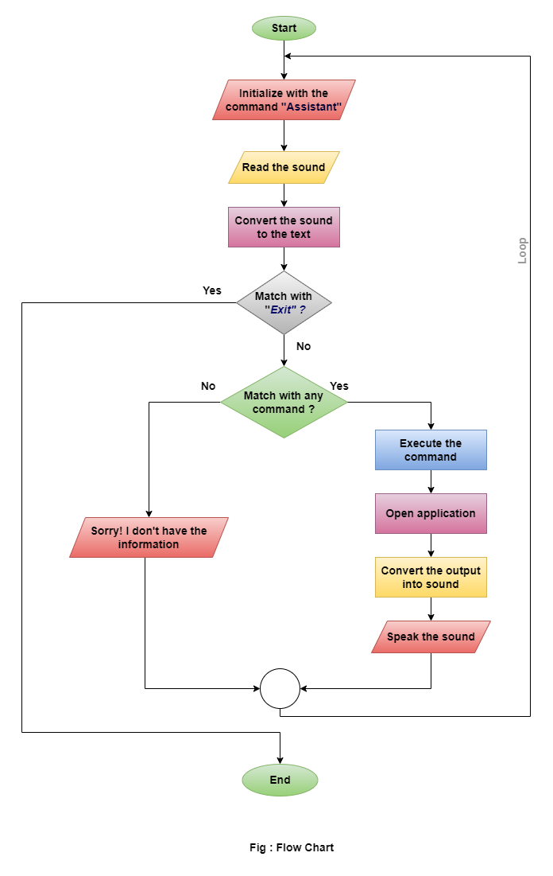
Workflow Diagram

Slide 9
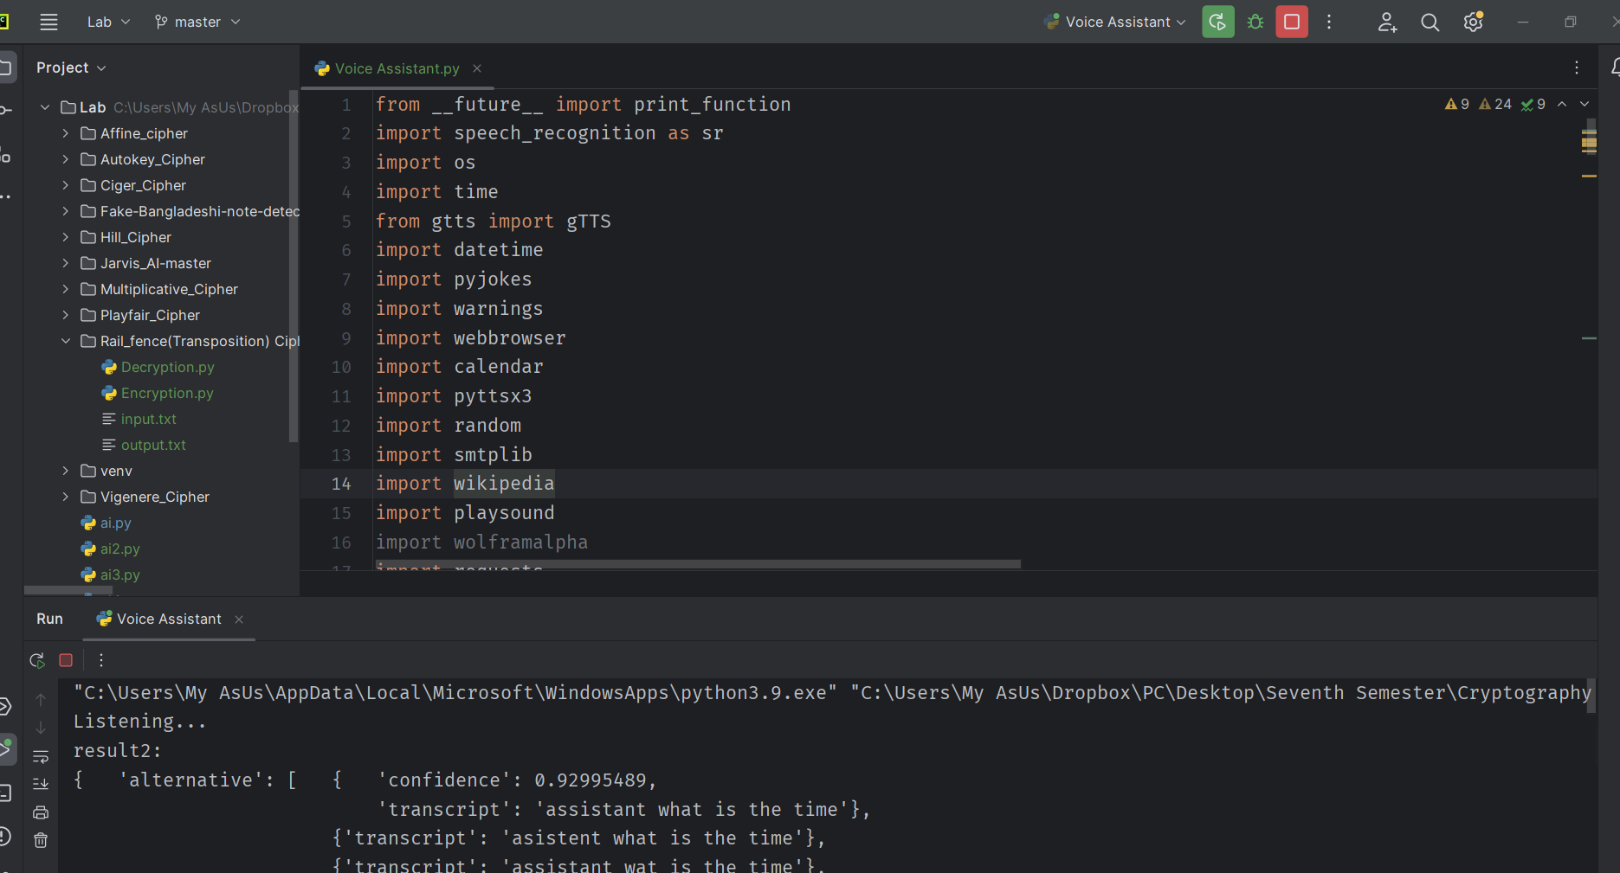
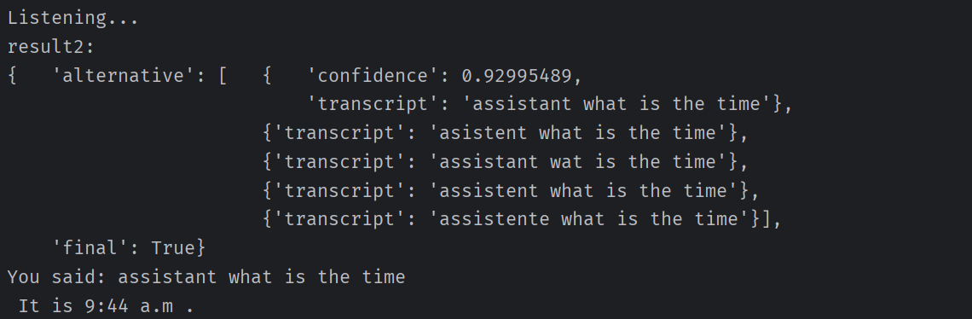
Project Demonstration
Its helps to operate our computer much easier way by giving the command. It can do app opening, weather report, take note, time, jokes, google search, news, email and many things like that.

Slide 10
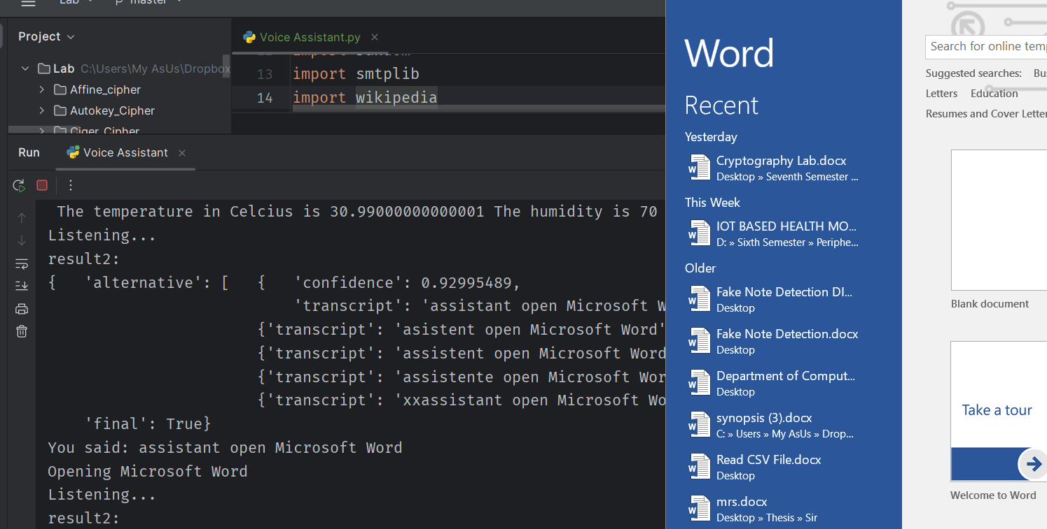
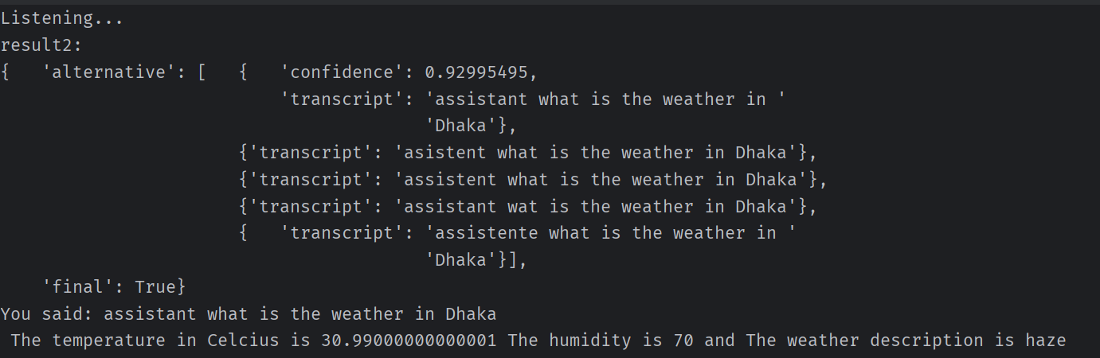
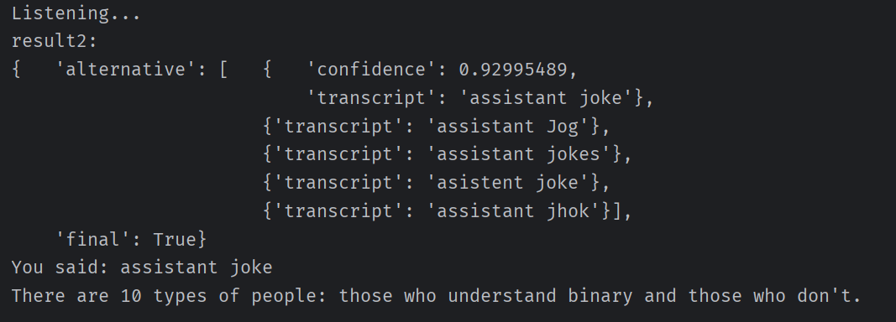
Project Demonstration

Slide 11
Result Analysis & Limitations
We want to calculate the performance or accuracy of our project, so we calculate the number of correct and incorrect word detection from our speech.
Total Number of Test | 50
Correct Detection | 42
Incorrect Detection | 08
Accuracy | 84%
Limitations:
We saw that there are 16% incorrect detection of our word which we command by speech. The main problem is that the surroundings noise and the microphone quality of the computer. If we had better microphone which support noise cancellation the performance can be improved.

Slide 12

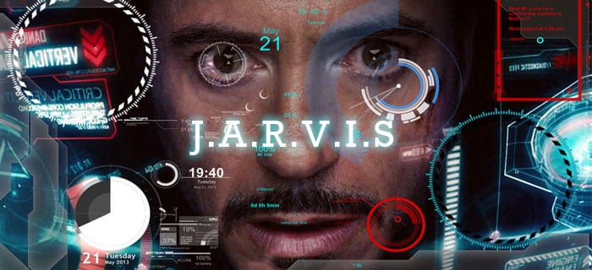
Project GitHub Link
https://github.com/Tanvir180/AI_Based_Personal_Virtual_Assistant

Slide 13
Reference
Lugano, Giuseppe. "Virtual assistants and self-driving cars." 2017 15th International Conference on ITS Telecommunications (ITST). IEEE, 2017.
Mekni, Mehdi. "An artificial intelligence based virtual assistant using conversational agents." Journal of Software Engineering and Applications 14.9 (2021): 455-473.
Gubareva, Regina, and Rui Pedro Lopes. "Virtual Assistants for Learning: A Systematic Literature Review." CSEDU (1) (2020): 97-103.
YouTube
Google

Slide 14
THANK YOU
Any Query?

